Slide 1
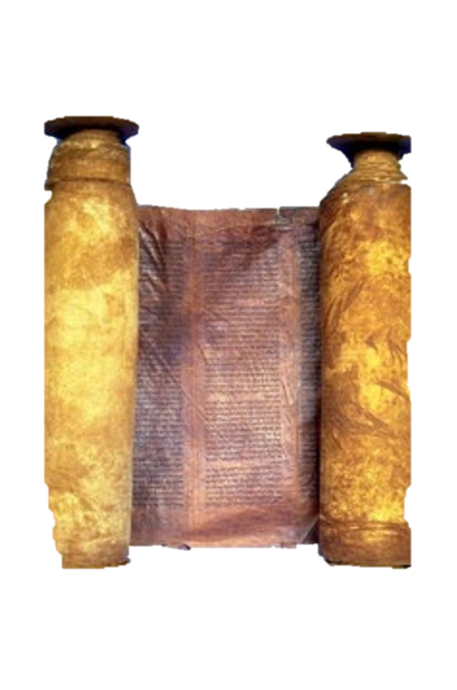
A free CD of this message will be available immediately following the service
2 Kings
14-16
A podcast will also be available later this week at calvaryokc.com

Slide 2
Israel
Judah
Ahaziah, 853-852
Jehoshaphat, 871-847
Jehoram, 852-841
Jehoram, 847-840
Azariah, 840
Jehu, 841-814
Athaliah, 840-835
Joash, 835-796
Jehoahaz, 814-798
Jehoash, 798-782
Amaziah, 796-768
2 kings 14-16

Slide 3
2 kings 14-16

Slide 4
Valley of Salt
Sela (Petra)
2 kings 14-16

Slide 5
2 kings 14-16

Slide 6
Israel
Judah
Ahaziah, 853-852
Jehoshaphat, 871-847
Jehoram, 852-841
Jehoram, 847-840
Azariah, 840
Jehu, 841-814
Athaliah, 840-835
Joash, 835-796
Jehoahaz, 814-798
Jehoash, 798-782
Amaziah, 796-768
2 kings 14-16

Slide 7
2 kings 14-16

Slide 8
Israel
Judah
Amaziah, 796-768
Jeroboam II, 782-753
2 kings 14-16

Slide 9
2 kings 14-16

Slide 10
Israel
Judah
Amaziah, 796-768
Jeroboam II, 782-753
Uzziah, 768-739
2 kings 14-16

Slide 11
2 kings 14-16

Slide 12
Israel
Judah
Amaziah, 796-768
Jeroboam II, 782-753
Uzziah, 768-739
Zechariah, 753-752
2 kings 14-16

Slide 13
2 kings 14-16

Slide 14
Israel
Judah
Amaziah, 796-768
Jeroboam II, 782-753
g
Uzziah, 768-739
Zechariah, 753-752
Shallum, 752
2 kings 14-16

Slide 15
2 kings 14-16

Slide 16
Israel
Judah
Amaziah, 796-768
Jeroboam II, 782-753
Uzziah, 768-739
Zechariah, 753-752
Shallum, 752
Menahem, 752-742
2 kings 14-16

Slide 17
2 kings 14-16

Slide 18
Israel
Judah
Amaziah, 796-768
Jeroboam II, 782-753
Uzziah, 768-739
Zechariah, 753-752
Shallum, 752
Menahem, 752-742
Pekahiah, 742-740
2 kings 14-16

Slide 19
2 kings 14-16

Slide 20
Israel
Judah
Amaziah, 796-768
Jeroboam II, 782-753
Uzziah, 768-739
Zechariah, 753-752
Shallum, 752
Menahem, 752-742
Pekahiah, 742-740
Pekah, 740-732
2 kings 14-16

Slide 21
2 kings 14-16

Slide 22
Israel
Judah
Pekah, 740-732
Jotham, 739-735
2 kings 14-16

Slide 23
2 kings 14-16

Slide 24
Israel
Judah
Pekah, 740-732
Jotham, 739-735
Ahaz, 735-715
2 kings 14-16

Slide 25
2 kings 14-16

Slide 26
Acts 17:21 ~ For all the Athenians and the foreigners who were there spent their time in nothing else but either to tell or to hear some new thing.
2 kings 14-16

Slide 27
2 kings 14-16

